Slide 1

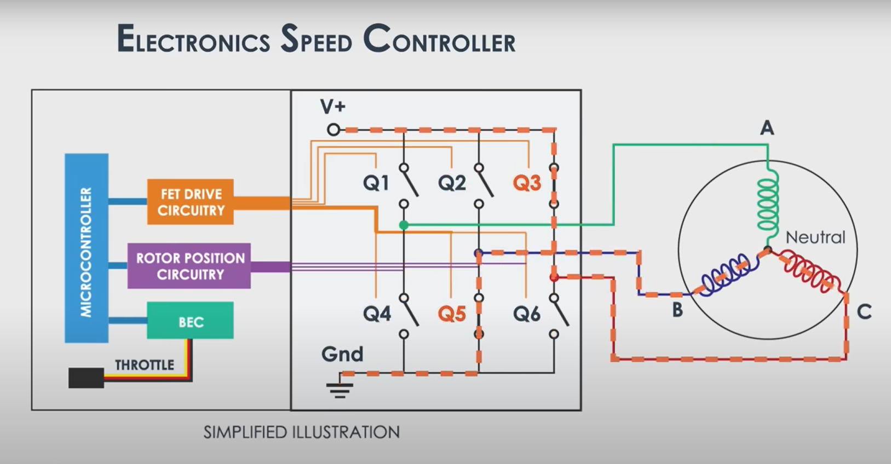
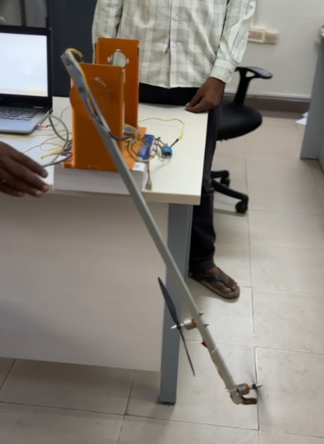
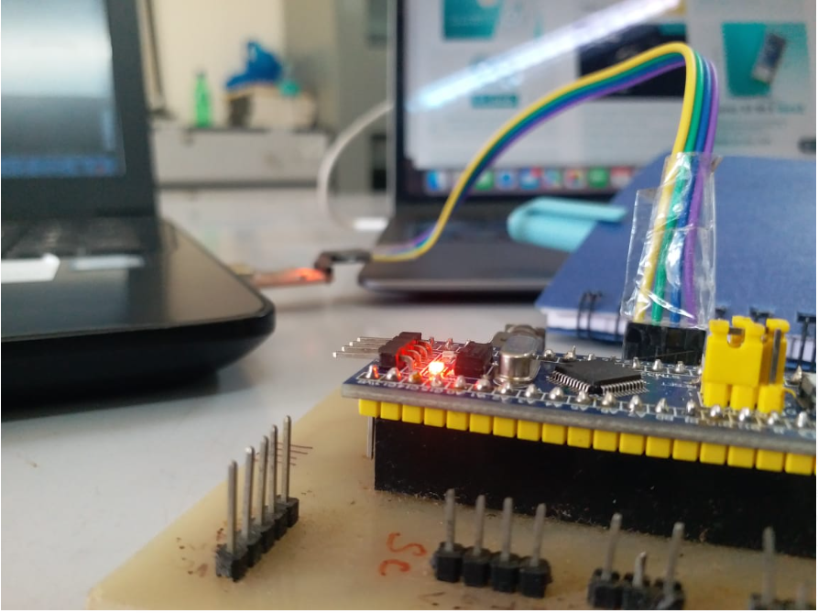
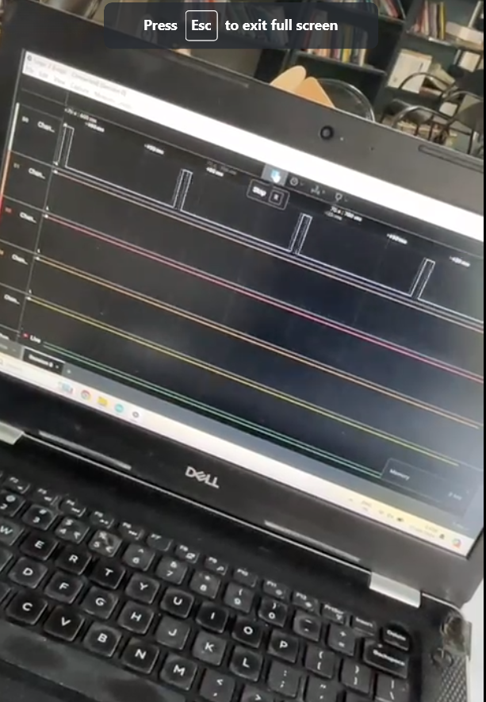
Microcontroller based Speed Control of BLDC motor
Ganesh XII Sri Sankara Vidhyashramam Mat.Hr.Sec. School
Dr. M. Senthil Kumaran , Associate Professor/ EEE
SHAPE 2024
Project Description
Circuit diagram/flowchart/algorithm/design
Photo of the Project
This project utilizes the power of a low-cost STM32 ARM processor to achieve precise speed control of Brushless DC (BLDC) motors, crucial components in quadcopter flying robotic applications. By harnessing the advanced capabilities of the STM32 platform, this system offers efficient and reliable motor control, ensuring optimal performance and stability during flight operations.
Objectives
Results/Data table
Outcome of the Project
Impact on Industry/Society
Develop precise BLDC motor speed control using STM32 ARM processor.
Maintain cost-effectiveness while meeting performance requirements for quadcopter applications.
Improve system integration to seamlessly incorporate the motor control solution into quadcopter platforms.
Compact quadcopter ideal for indoor surveillance, mapping, education, and hobbyist projects. Maneuverable in confined spaces, offering versatile applications despite limited area. Perfect for indoor entertainment and Demo’s
A
B
Conclusion
the compact quadcopter offers versatile applications despite limited space, serving purposes ranging from indoor surveillance to educational demonstrations and hobbyist projects. Its maneuverability and adaptability make it invaluable.
Novelty
This project ingeniously employs a budget-friendly STM32 ARM
processor for precise speed regulation of BLDC motors in quadcopters. Customized control algorithms, fine-tuned for quadcopter dynamics, elevate stability and responsiveness, setting it apart from standard methods. Its affordability democratizes advanced motor control, seamlessly integrating into quadcopter systems for efficient, compatible operation.
References
RM0008 Reference manual
DRV8306 38-V Brushless DC Motor Controller datasheet
. RM0090 Reference Manual
TMC603A Data Sheet

